Slide 1
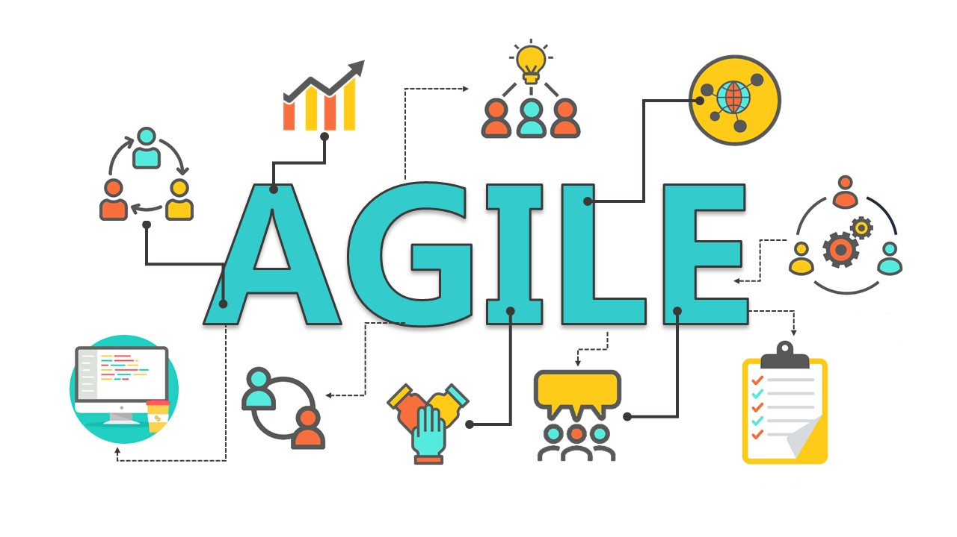

Slide 2
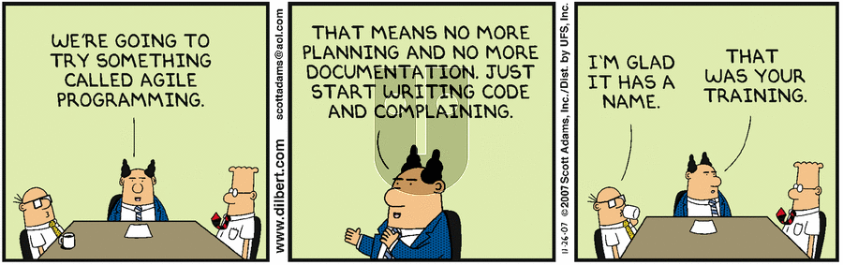

Slide 3
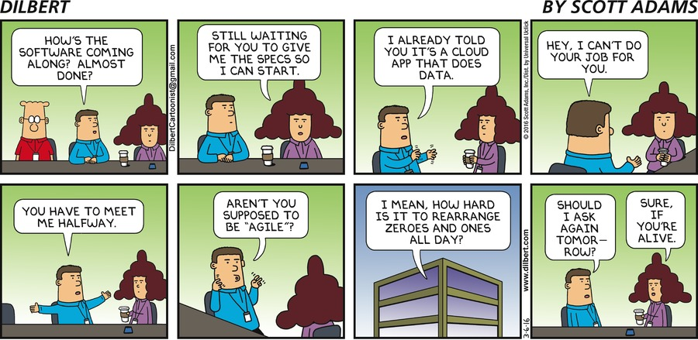

Slide 4

Waterfall
Published in 1970s
Software Development Process
Sequential Software Development Life Cycle

Slide 5
Waterfall: architecture
System Design
Testing
Maintenance
Collect and documenting all the requirements
Very completed analysis of the system
Developers create the software
Few phases with necessary iterations
Ready for the production environment
Usually with a contracts
Requirement / Analysis
Implementation
Deployment

Slide 6
Waterfall: advantages
Very detailed projects
Robust scope
Maintain design structure
Suitable for large projects or organization
Required strict procedure and deadline
Extensive documentation is required
Suitable for milestone-focused development

Slide 7
Waterfall: disadvantages
Non adaptive design constraints
Lack of adaptation
Ignore/moderate user/client feedback
Delayed the period of testing

Slide 8
Waterfall: project manager
Time bounded
Required definitive effort
Needs to be well planed
Must be completed within the assigned budget

Slide 9
Waterfall: project manager: Pros
Easy to learn and understand
Extensive documentation
Suitable for small projects

Slide 10
Waterfall: project manager: cons
Lack of flexibility
Testing process can be risky
Not suitable for large, complex projects

Slide 11
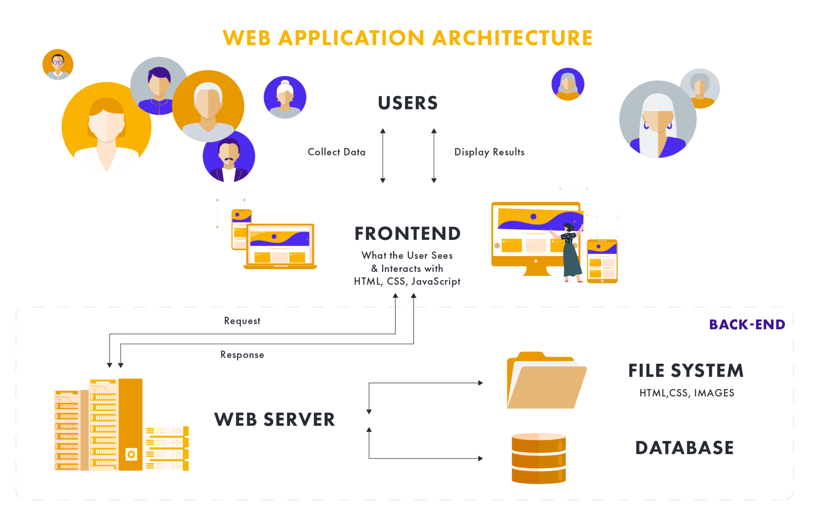
Waterfall: a real example

Slide 12
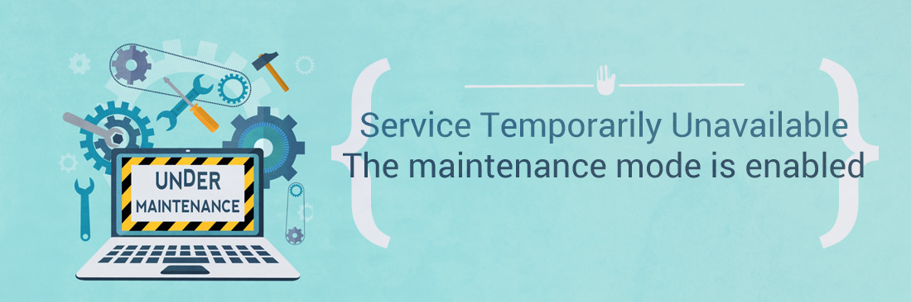
Waterfall: a real case
Massive structure to deploy
Extensive downtime of the system
Impacts to other applications (mobile apps, connected services…)

Slide 13
Waterfall: summary
Perfect for very detailed project from the beginning
Structured organizations
Changes only in early stages
Suitable for milestone-focused development

Slide 14

Agile

Slide 15
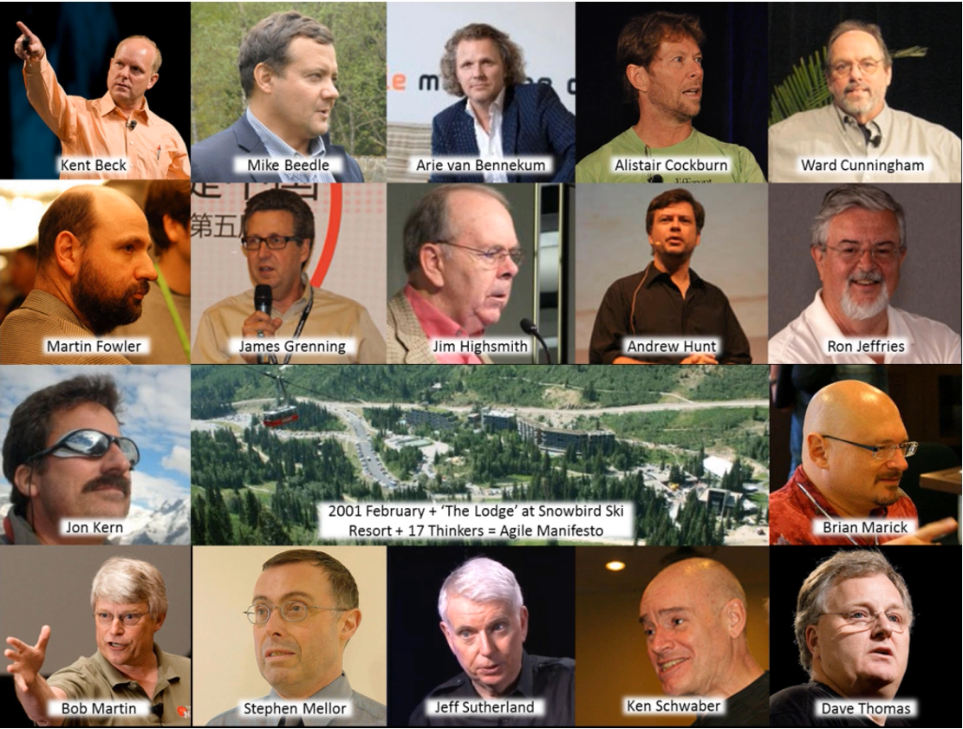
Agile was born
In 2001, a group of software developers gathered in a ski resort in the town of Snowbird, Utah, to discuss emerging approaches.

Slide 16
Agile manifesto
We are uncovering better ways of developing software by doing it and helping others do it. Through this work we have come to value:
Individuals and interactions over processes and tools
Working software over comprehensive documentation
Customer collaboration over contract negotiation
Responding to change over following a plan
That is, while there is value in the items on the right, we value the items on the left more.
Signed by Kent Beck, Mike Beedle, Arie van Bennekum, Alistair Cockburn, Ward Cunningham, Martin Fowler, James Grenning, Jim Highsmith, Andrew Hunt, Ron Jeffries, Jon Kern, Brian Marick, Robert C. Martin, Steve Mellor, Ken Schwaber, Jeff Sutherland, Dave Thomas
Available on agilemanifesto.org

Slide 17
Individuals and interactions over processes and tools
Increase performances up to 50%
More specific communication between individuals

Slide 18
Working software over comprehensive documentation
Things change
Specification becomes quickly out of date

Slide 19
Customer collaboration over contract negotiation
Waterfall
Companies have to negotiate the requirements
Clients are not involved in the development process
Agile
Clients are engaged and collaborate with the developer team
Fix as little as possible
Decision with clients and stakeholders

Slide 20
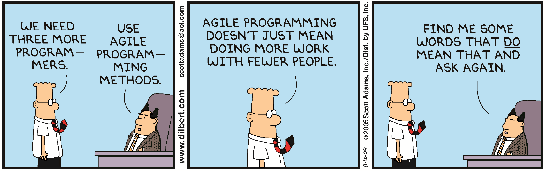
Responding to change over following a plan
Waterfall
60% of features with Waterfall are not used
Methods, requirements, cost and timing are set in the stone
Agile
Allows and embraces changes

Slide 21
THE AGILE METHOD
Agile project management utilizes the principles and application of Agile software development. Unlike traditional project management, the agile methodology encourages customer needs and collaboration, minimizes resources, increase flexibility to bring rapid iterations and faster turnaround times.
Customer centricity
Flexibility
Working solutions
Maximum business value in minimum time
Rapid iterations
Contact negotiation
Rigid planning
Comprehensive documentation
Delayed business value due to longer release cycles
Agile
VS
Waterfall

Slide 22
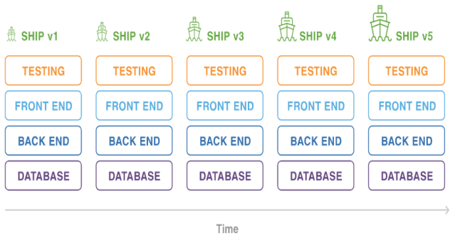
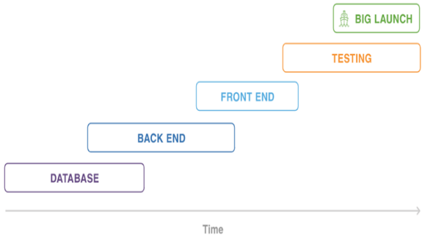
Waterfall vs Agile
Waterfall
Built in phases
Painful to revisit previous phases
High dependency on critical paths
Customer can’t interact with product until it’s fully complete
Agile
Follows iterative approach
Regular feedback intervals
Iterations resolve blocking issue & let you interact with the product
Quickly adapt new requirements/changes
Shared skillset among the team

Slide 23
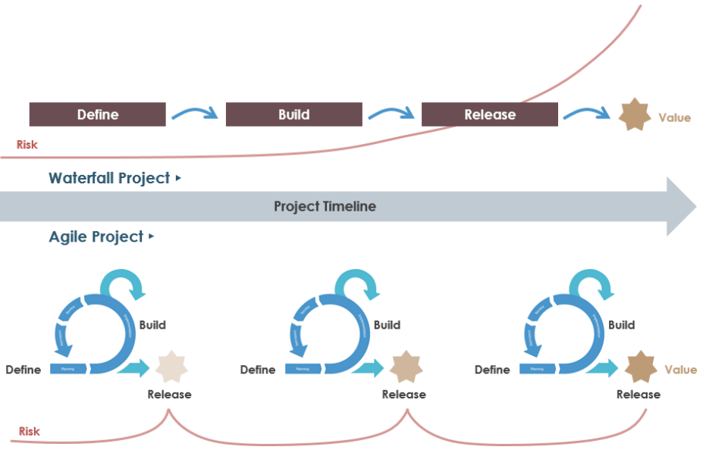
Waterfall vs Agile

Slide 24
Waterfall vs Agile
 | Waterfall | Agile
Sequential | X
Flexible |  | X
Accommodate change |  | X
Defined requirements | X
Deliver quality products | X | X
Continually evolving |  | X
Rigid process | X

Slide 25
Use Waterfall if…
You don’t expect changes in scope and you’re working with fixed-price contracts
The project is very simple or you’ve done it many times before
Requirements are very well known and fixed
Customers know exactly what they want in advance
You’re working with orderly and predictable projects

Slide 26
Use Agile if…
The final product isn’t clearly defined
The clients/stakeholders need the ability to modify the scope
You anticipate any kind of changes during the project
Rapid deployment is the goal

Slide 27
Agile Principles
Our highest priority is to satisfy the customer through early and continuous delivery of valuable software.
Welcome changing requirements, even late in development. Agile processes harness change for the customer's competitive advantage.
Deliver working software frequently, from a couple of weeks to a couple of months, with a preference to the shorter timescale.
Business people and developers must work together daily throughout the project.
Build projects around motivated individuals. Give them the environment and support they need, and trust them to get the job done.
The most efficient and effective method of conveying information to and within a development team is face-to-face conversation.
Working software is the primary measure of progress.
Agile processes promote sustainable development. The sponsors, developers, and users should be able to maintain a constant pace indefinitely.
Continuous attention to technical excellence and good design enhances agility.
Simplicity - the art of maximizing the amount of work not done - is essential.
The best architectures, requirements, and designs emerge from self-organizing teams.
At regular intervals, the team reflects on how to become more effective, then tunes and adjust its behaviour accordingly.

Slide 28




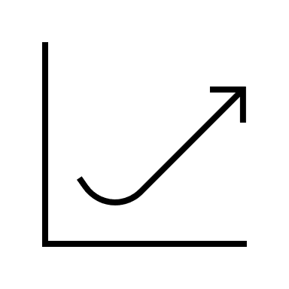






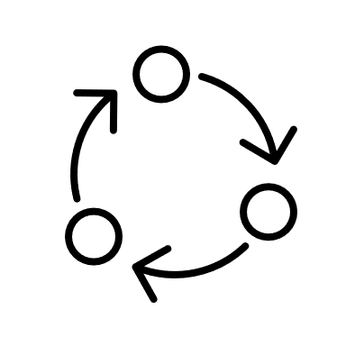
Agile Principles
Customer satisfaction
Welcome change
Delivery frequently
Working together
Motivated team
Face-to-face
Working software
Constant pace
Good design
Simplicity
Self Organization
Reflect and adjust

Slide 29
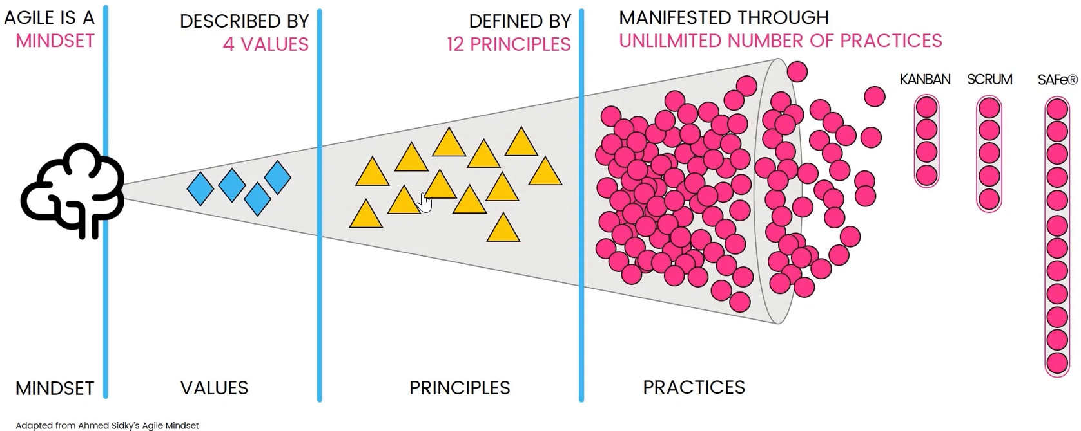
Agile mindset

Slide 30
Agile Test: Litmus test
Does what we are doing at this moment support the early and continuous delivery of valuable software?
Does our process welcome and take advantage of change?
Does our process lead to and support the delivery of working functionalities? Are the developers and the product owner working together daily?
Are customers and business stakeholders working closely with the project team?
Does our environment give the development team the support it needs to get the job done?
Are we communicating face to face via Microsoft Teams (or other software) more than through phone and email?
Are we measuring progress by the amount of working functionality produced?
Can we maintain this pace indefinitely?
Do we support technical excellence and good design that allows for future changes?
Are we maximizing the amount of work not done - namely, doing as little as necessary to fulfill the goal of the project?
Is this development team self-organizing and self-managing? Does it have the freedom to succeed?
Are we reflecting at regular intervals and adjusting our behavior accordingly?

Slide 31
Agile Test: Litmus test
If you answer YES to all these questions, you are really working on an Agile environment
If you answer NO to 1 or 2 of these questions, what can you do to change that answer to YES?
If you answer NO to most of the questions, you have to consider if you want to adopt Agile, how to implement it and what benefits it could have for your team

Slide 32
Agile is not…
A specific way of doing software development
A framework, standard or a process
An end-goal by itself
An excuse to stop reducing documentation or an opportunity to eliminate planning
One size fits all (in fact, it is a tailored approach for an organization's unique vision, culture and specific needs)
Scrum (Scrum follows Agile principles)
Kanban (Kanban applies Agile principles)
Limited to software developments

Slide 33
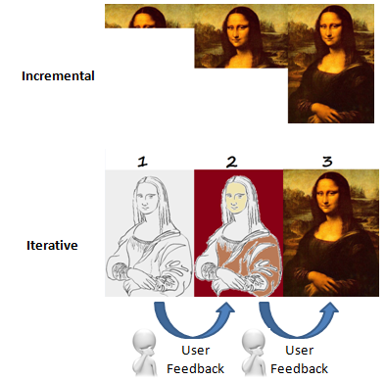
What Agile is
Refers to any process that aligns with the Agile Manifesto
Based on incremental delivery and iterative approach
Encourage constant feedback
Deliver value faster

Slide 34
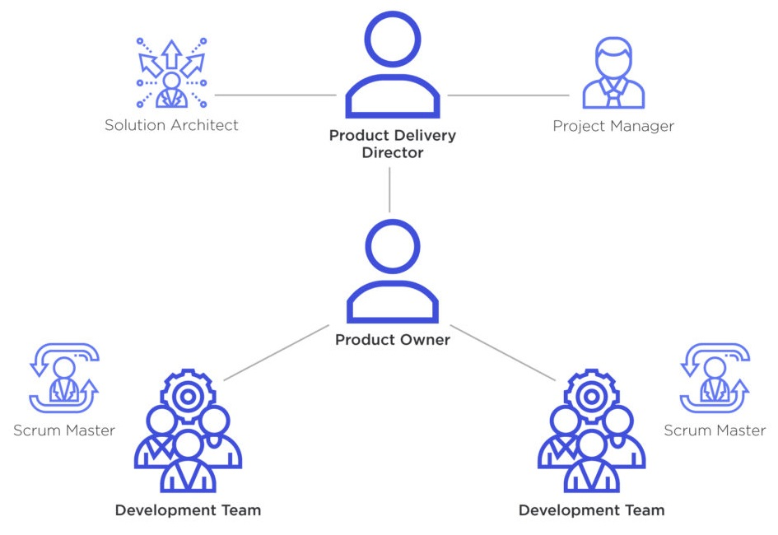
Agile Team Structure

Slide 35
Product owner
Responsible for the product backlog
Product vision
Managing stakeholders
Valuable insights

Slide 36
Team Lead / Scrum master
Lead and guide the team
Facilitate communication and processes
Available all the time to answer questions

Slide 37
Developer team
Responsible to deliver the product at the end of each sprint
Meet customer’s needs
Members
Developers
Designers
Testers
Quality Assurance (QA)

Slide 38
Stackholder
Internal or external clients
Guide how to deal with issues

Slide 39
Agile Key Concepts

Slide 40
User story
User Story
Action/Goal
Benefit
Acceptance Criteria
Role
Work divided into functional increments called “user stories”
Short description of a feature from the perspective of the person who desires the new capability
User story should be potentially shippable
Size of a user story is measured in story points
In software development, the goal is often a new product feature targeting the end user and the reason is the benefit that the user sees in the targeted product. Feature user story typically follow a simple template, which you can see below.

Slide 41
User story structure
Role
Action/Goal
Benefit
Acceptance criteria

Slide 42
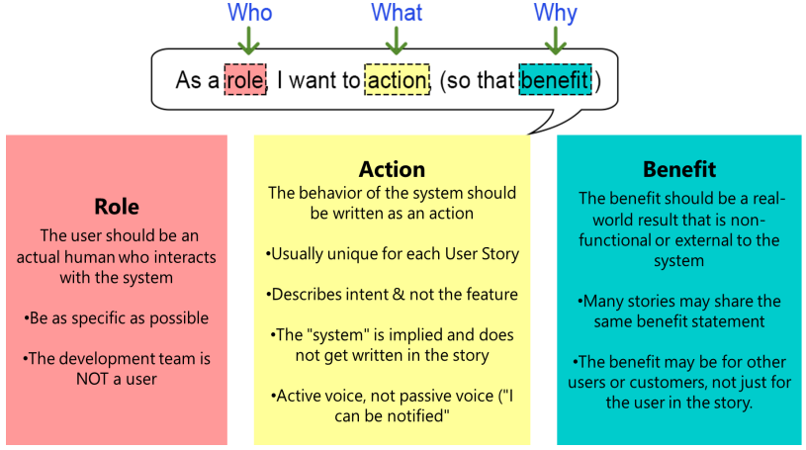
User story structure

Slide 43
Role
As a ROLE, I want to ACTION
As a ROLE, I want to BENEFIT
The user should be an actual human who interacts with the system
The development team is NOT a user

Slide 44
Action
As a ROLE, I want to ACTION
As a ROLE, I want to BENEFIT
Describe the behaviour of the system
Describe the intent of the user story (not the feature)
Unique for each user story

Slide 45
Benefit
As a ROLE, I want to ACTION
As a ROLE, I want to BENEFIT
Users immediate desire to do something
Describe the big problem they want to resolve
Real world result
More user stories share the same benefit

Slide 46
Acceptance criteria
Requirement that must be met and the answer must be Yes/No
Must be testable
Should be clear and concise
Everyone must understand
Should provide user perspective
Acceptance criteria is known as
Definition of Done (DoD)

Slide 47
Acceptance criteria: format
Given
When
Then
Given some precondition When I do some action Then I expect some result

Slide 48
Acceptance criteria: who is responsible?
Usually the product owner
Team members can help writing the content of the user story
Accept input from stakeholders
Must be written before development begins

Slide 49
INVEST
Independent (of all others)
Negotiable (not a specific contract for features)
Valuable
Estimable (to a good approximation)
Small (so as to fit within an iteration)
Testable (in principle, even if there isn’t a test for it yet)

Slide 50
User story examples
As a [customer],
I want [shopping cart feature]
so that [I can easily purchase items online].

Slide 51

User story examples
As a [manager],
I want to [generate a report]
so that [I can understand which departments need more resources].
Acceptance criteria: display a report with the actual resources for each department

Slide 52
User story examples
As a [customer],
I want to [receive an SMS when the item is arrived]
so that [I can go pick it up right away].

Slide 53

User story examples
As a [development team],
we want to [see a report of the open tasks in this sprint]
so that [we can organize the next sprint].

Slide 54
User story examples
As a [manager],
I want to be able to [understand my colleagues progress]
so I can [better report our success and failures].

Slide 55
User story examples
Acceptance criteria
Given the fridge is on
And the door is closed And the light bulb is in working order,
When I open the door,
Then the light turns on

Slide 56
User story examples
As a [online visitor],
I want to [add products in my shopping cart]
so that [I can purchase multiple products at one go].
Acceptance criteria
Products can be added to the cart
Products can be removed from the cart.
Shopping cart will be empty initially
Shopping cart will be empty after purchase
Products can be added with multiple quantities in the cart
Shopping cart will show the total product breakdown quantity and cost with grand total

Slide 57
Epic
Series of user stories with a broader strategic objective
A large user story that cannot be delivered as defined within a single iteration or is large enough that it can be split into smaller user tasks/user stories
No standard format to represent epics
Epic
Story 1
Story 2
Story 3

Slide 58
Epic example
Selecting Marketing Campaigns 1
As a [Vice President Marketing],
I want to [review the performance of historical promotional campaigns]
so that [I can identify and repeat profitable campaigns].
1a: As a VP Marketing, I want to select the timeframe to use when reviewing the performance of past promotional campaigns, so that...
1b: As a VP Marketing, I can select which type of campaigns (direct mail, TV, email, radio, etc.) to include when reviewing the performance of past so that...
1b1: As a VP Marketing, I want to see information on direct mailings when reviewing historical campaigns so that...
1b2: As a VP Marketing, I want to see information on TV ads when reviewing historical campaigns so that...
1b3: As a VP Marketing, I want to see information on email ads when reviewing historical campaigns so that...

Slide 59
Initiative
Initiatives are collections of epics that drive toward a common goal
The product roadmap is expressed and visualized as a set of initiatives plotted along a timeline
Completion of epics will lead to the completion of the initiative

Slide 60
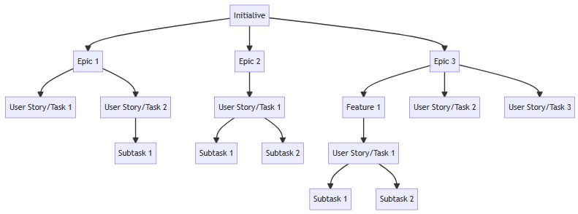
Initiative

Slide 61
Feature (only Scrum)
Used only in Scrum
Collection of user stories
Provide business value
Be estimable
Small enough
Be testable

Slide 62
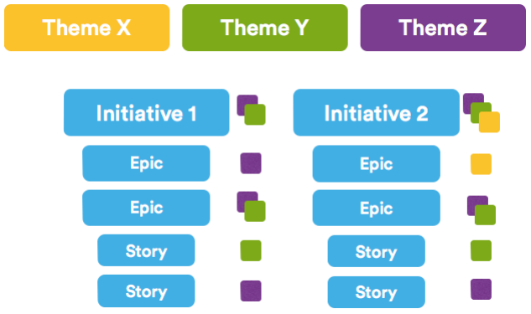
Themes

Slide 63
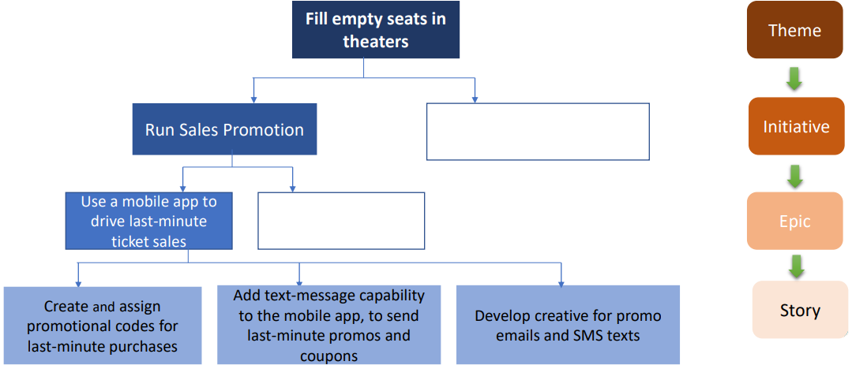
Relationship

Slide 64
Product log
Lists & Prioritizes the task-level details to execute a plan- To do list
Includes user stories, new features, changes to existing functionalities, bug fixes, and other tasks like infrastructure changes etc.
Single source of requirements that defines the product
Contains short description of functionality desired in the product
Can be represented in physical form or in electronic form
Owned & maintained by the product owner
User Stories is the most common format
Dynamic in nature: addition, deletion and reordering of requirements possible

Slide 65
Vision
Product vision
Product Goals
Product roadmap
Release Plan & Backlog

Slide 66
AGILE ROADMAP
Risk Level 1
Risk Level 2
Risk Level 3
YEAR 1
YEAR 2
JAN
FEB
MAR
APR
MAY
JUNE
JULY
AUG
SEPT
OCT
NOV
DEC
JAN
FEB
MAR
APR
MAY
JUNE
JULY
AUG
SEP
WORK STREM 1
Action
Description
Text
Description
Action
Action
Text
Description
WORK STREM 2
Description
Description
Text
Description
Description
Description
Description
Description
WORK STREM 3
Description
Action
Action
Text
Description
Action
Description
Text

Slide 67
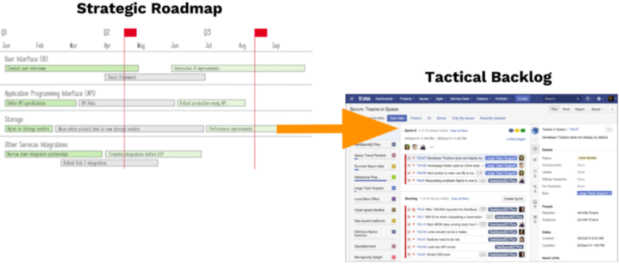
Strategic roadmap vs Tactical backlog

Slide 68
Product roadmap vs product backlog
Content | High-level: themes and epics or outcomes and goals | Task-level: user stories and defects
Audience | Executive team (and other stakeholders) | Primary for product and development teams
Intent | Convey a strategy | Conveys tactical steps in execution of plan
Time frame | Varies, typically ~3 Months | 1 or 2 sprints

Slide 69
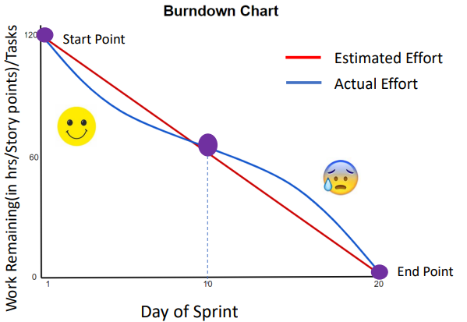
Burn down chart

Slide 70
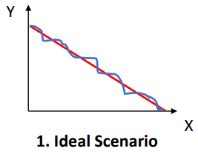
Burn down chart: ideal scenario

Slide 71
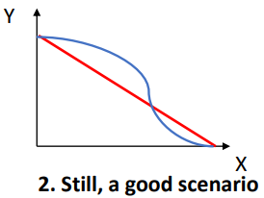
Burn down chart: good scenario

Slide 72
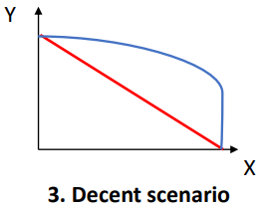
Burn down chart: decent scenario

Slide 73
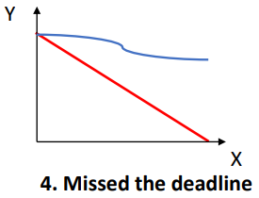
Burn down chart: missed deadline scenario

Slide 74
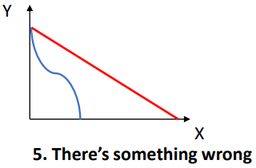
Burn down chart: 😶‍🌫️ scenario

Slide 75
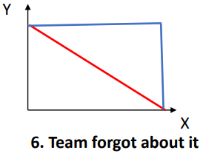
Burn down chart:🤐

Slide 76
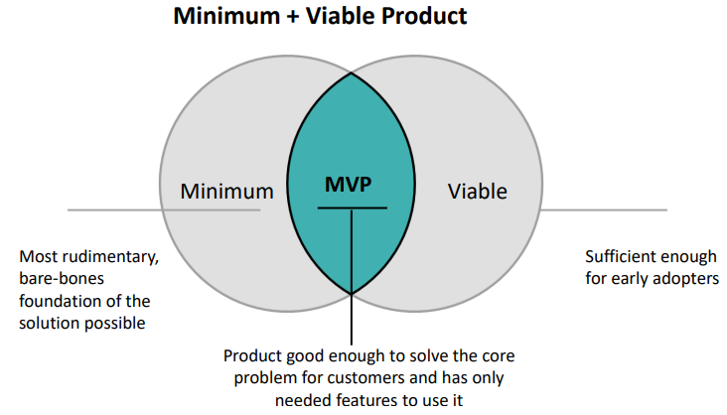
Minimum Viable Product (MVP)

Slide 77
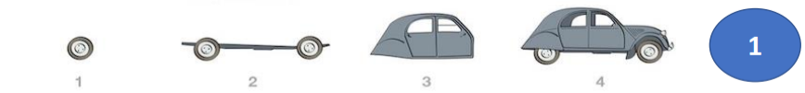
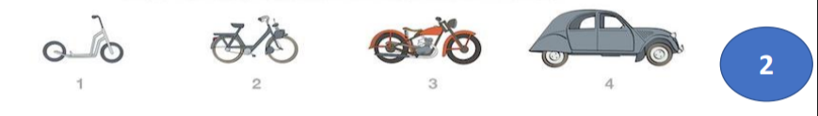
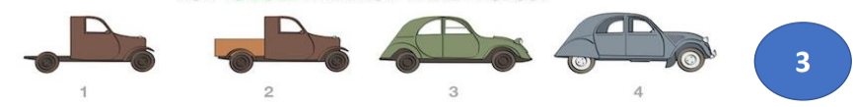
Minimum Viable Product (MVP)

Slide 78
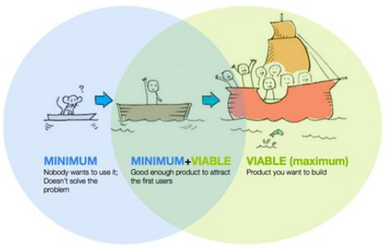
Why MVP
Release a product to the market as quickly as possible
Test an idea with real users before committing a large budget to the product’s full development
Learn what resonates with the company’s target market and what doesn't

Slide 79



Example of MVP

Slide 80
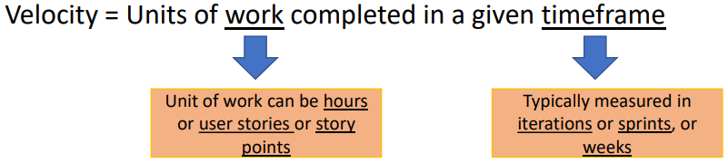
Velocity
At the end of each iteration, the team adds up effort estimates associated with user stories that were completed during that iteration.
This total is called velocity.

Slide 81
Velocity: example
User Stories | Story points | Status
A | 3 | Complete
B | 5 | Incomplete
C | 8 | Completed
Velocity = 3 + 8 = 11 Story point

Slide 82
Velocity: example
Sprint | Story points
1 | 11
2 | 13
3 | 6
Velocity = (11 + 13 +6) / 3 = 10
You need to successfully completed at least 3 sprints to get a better visibility and plan future sprints

Slide 83



Velocity example
User story: 60 points
Average velocity: 10 points
6 sprints

Slide 84
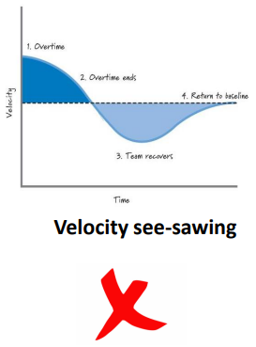
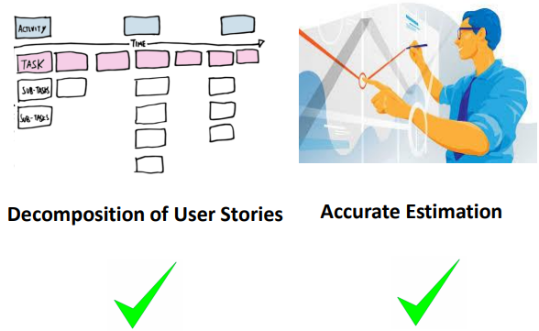
Velocity see-sawing

Slide 85
Quick Sprint velocity test
SPRINT 1
Assuming that in Sprint 1, team committed to total of 5 user stories
Story point of each of the user story = 8 story points
Total story points committed by team in sprint 1 = 40 story points
By end of sprint 01 team completed 3 out of 5 user stories
SPRINT 2
Assuming that in sprint 02, team committed to total of 7 user stories
Story point of each of the user story = 8 story points
Total story points committed by team in sprint 01 = 56 story points
By end sprint team completed 4 out of 7 user stories
SPRINT 3
Assuming that in sprint 03, team committed to total of 9 user stories
Story point of each of the user story = 8 story points
Total story points committed by team in sprint 03 = 72 story points
By end sprint 03, team completed 5 out of 9 user stories
Q1. Calculate Velocity for each of the Sprint 1,2 and 3.
Q2. Calculate Average Velocity of Sprint 1,2 and 3.
Q3. Suppose the user stories remaining represent a total of 160 story points, in how many sprints the project will get completed?

Slide 86
Estimation
Tradition estimation | Agile estimation
Efforts were estimated | Business values or Complexity is estimated
Unit: Hours | Unit: Story Points or bucket
Estimation is done in task level | Estimation is done in user story level
Provides absolute estimate | Provides relative estimate
Estimates once done are not revised | Estimates are revisited in every iteration

Slide 87
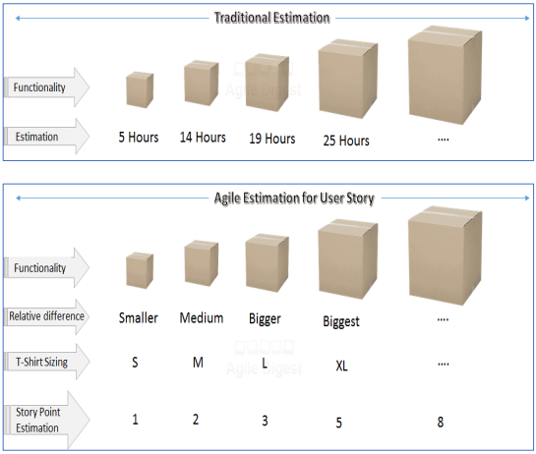
Estimation

Slide 88
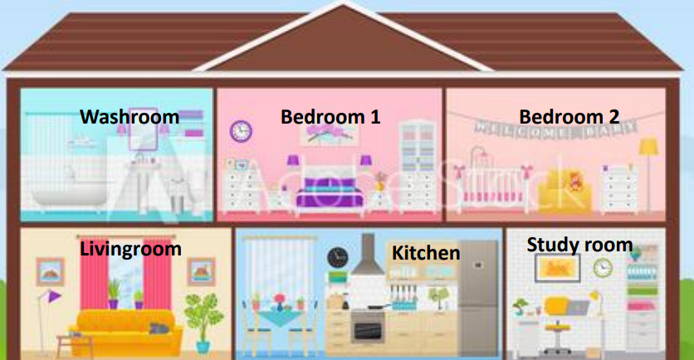
Estimation: example
Room | Story point
Study room | 3
Bedroom 1 | 5
Bedroom 2 | 5
Kitchen | 8
Business value
Complexity
Risks
Dependencies
Amount of work

Slide 89
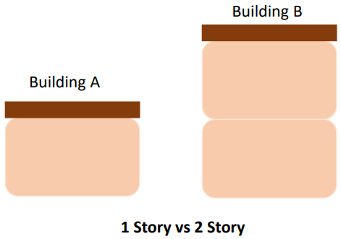
Why relative estimation?
Humans are not great guessing numbers
Larger the items, the hardest to guess

Slide 90
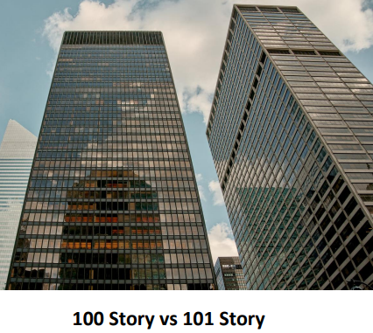
Why relative estimation?
Which is the tallest?

Slide 91
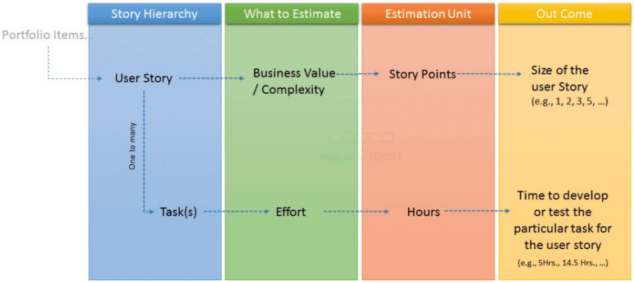
Story point as reward

Slide 92
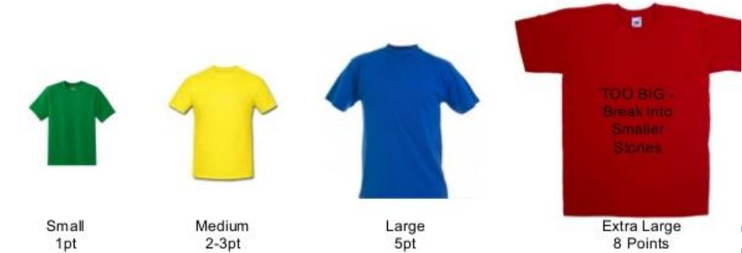
Estimation method

Slide 93
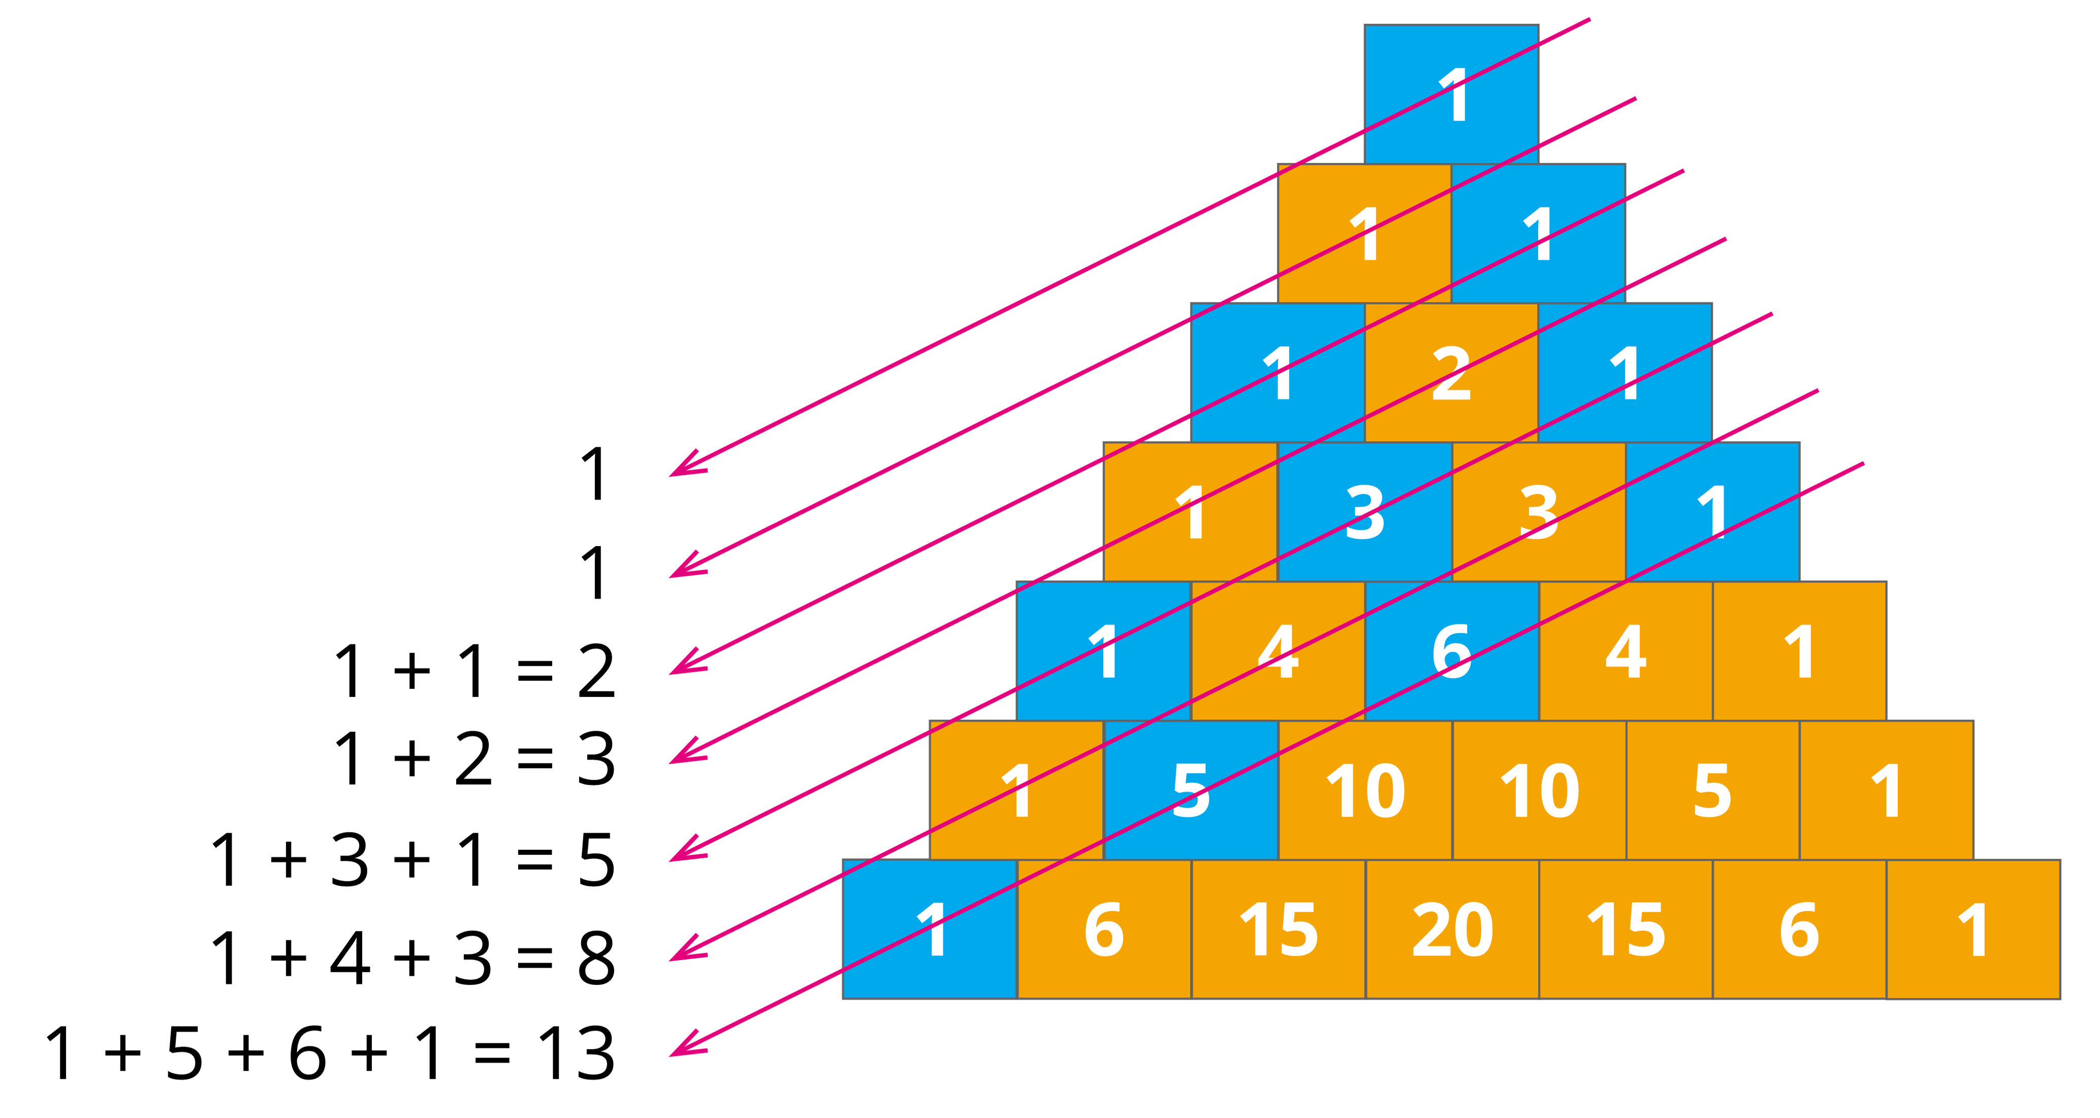
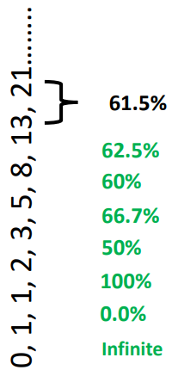
Estimation method

Slide 94
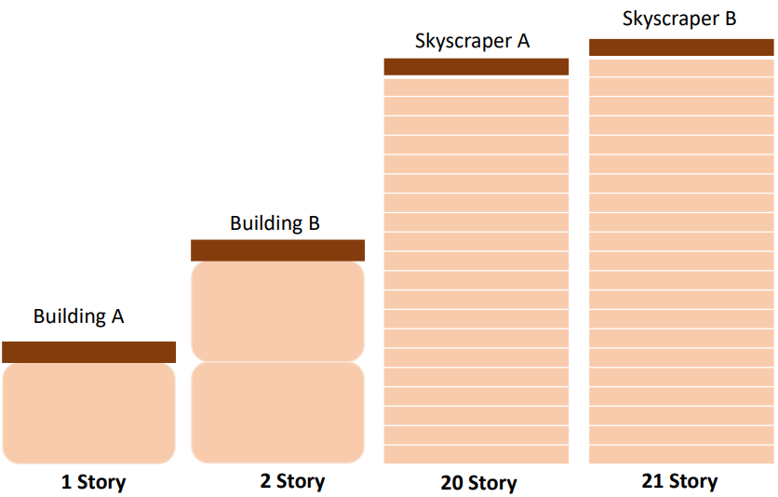
Why Fibonacci?

Slide 95
Guideline
Points | Explanation | Example
1 | Quick to deliver and minimal complexity | Add field to a form. An hour
2 | Quick to deliver and some complexity | Add parameter to form, validation, storage. Multiple hours
3 | Moderate time to deliver, moderate complexity, possible unknowns | Migrate somewhat complex static CSS into a CSS pre-processor
5 | Longer time to deliver, high complexity, likely unknowns | Integrate with third-party API for pushing/pulling data, and link to user profiles in platform
8 | Long time to deliver, high complexity, critical unknowns | Overhaul the layout/HTML/CSS/JS of a web application
13 | Long time to deliver, high complexity, many critical unknowns | Migrate application from an outdated data store to new DB technology and ORM
21 | You are doing something wrong 😉

Slide 96
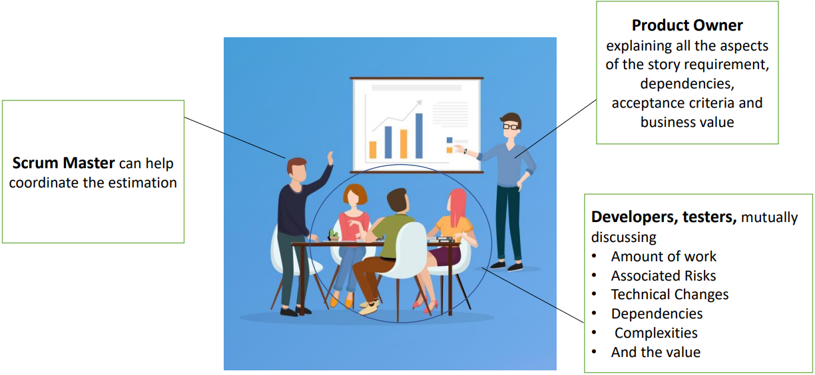
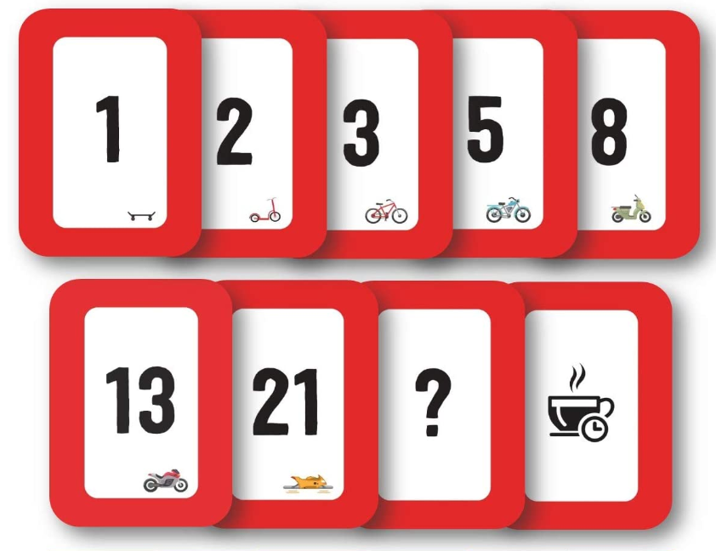
Planning poker

Slide 97
Are you still alive?

Slide 98
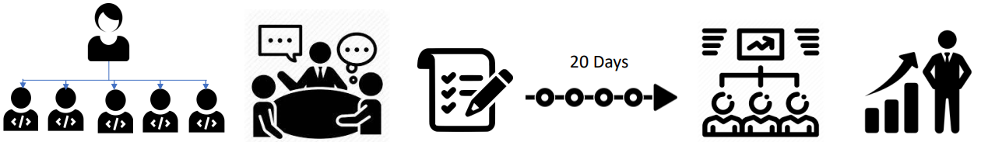
What is a framework?

Slide 99
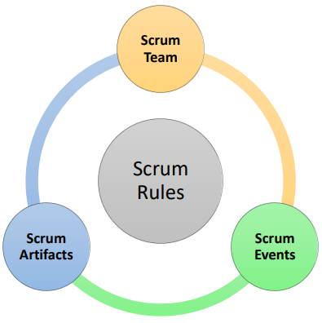
Scrum
Scrum is a framework based on Agile
Scrum team
Scrum events
Scrum artifacts
Scrum rules

Slide 100
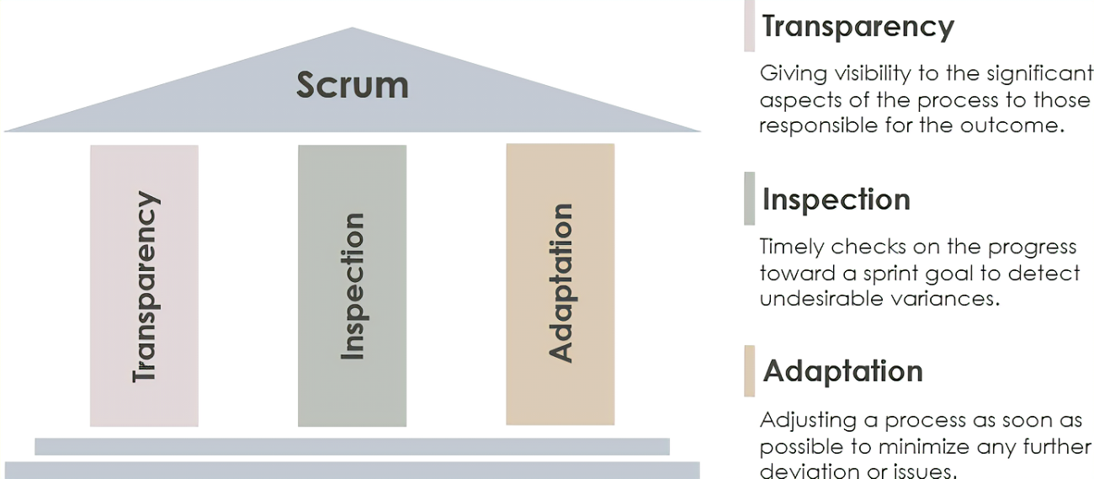
3 pillars of Scrum

Slide 101
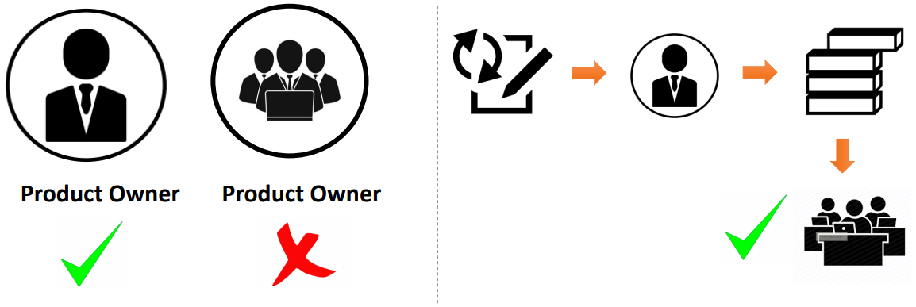
Product owner
Responsible of the product backlog
Discuss the requirement with the business
Ordering the backlog

Slide 102
Development team
Must be cross-functional
Self-organizing
No title
No subteams
It works only on the list in the backlog
No one tells them how the work is to be done
3/9 members

Slide 103
Scrum master
Ensure proper practical implementation of all concepts
All Scrum related things such as maintaining the product backlog, helping the development team create high value products etc.
Facilitating Scrum Events
Ensure Scrum Artifacts are properly maintained
Single point of contact to understand Scrum

Slide 104
Sprint
The product owner of the Acme app and you have a meeting with the business team
The business team gives a list of tasks to be done
You estimate that the development time to be 40 days for creating the next releasable version of the app
For the next 40 days, the development team works on that list and you deliver the product.
Then, repeat
Is this Agile?

Slide 105

Sprint

Slide 106
Sprint planning
Sprint planning happens once in each Sprint
Entire Scrum Team: Product Owner, Scrum Master & Development Team must be a part of the event
Time box for the event is 8 hours (upper limit)
Two agendas
What is to be done in this Sprint
Establish how it will be done

Slide 107

Daily Scrum
Time boxing event: 15 minutes
Each person explains what (s)he did yesterday and what the plan is for today
The members with less experience start the Daily Scrum
Illustrate issues or blockers to stop the team to achieve the sprint’s goal

Slide 108
Sprint retrospective
Growing the team
Improve relationships, processes and tools
Time boxed event: max 3 hours
What went well
What improve
Actions

Slide 109
Product backlog (product backlog refinement)
Business team provides raw requirements (no technical requirement)
Product owner refines the requirements
Based on the both estimations, the product owner orders the requirements
Details are capture clearly
Tasks can be done in the next sprint
Time boxed: no more than 10% of the capacity of the dev team

Slide 110

Increment

Slide 111
Pros and cons
Pros
More transparency and project visibility
Increased team accountability
Easy to accommodate changes
Increased cost savings
Faster Delivery
Customers are heard
Cons
Risk of scope creep
Team requires experience and commitment
The wrong Scrum Master can ruin everything
Poorly defined tasks can lead to inaccuracies

Slide 112

Typical team

Slide 113
Documentation
GitHub repo https://github.com/CelloHealthInsight/agile
GitHub Pages https://cellohealthinsight.github.io/agile

